Slide 1
Little Wandle
Letters and Sounds
Heymann Primary and Nursery School

Slide 2

Just click on the pencil and it will show you how to form the letter.
Press the back button at any time during the slide show to return to the letter choice screen.

Slide 3
Click on the letter you would like to practise.
a
c
e
f
g
b
d
h
j
m
n
o
p
q
i
k
l
r
s
t
u
v
x
y
z
w

Slide 4


a
Watch the pencil
Around the astronaut’s helmet, and down into space
Click on the pencil to see it write.

Slide 5

Watch the pencil
Down bear’s back, up and round his big tummy.
Click on the pencil to see it write.

Slide 6

c
Watch the pencil
Curl around the cat
Click on the pencil to see it write.

Slide 7

d
Watch the pencil
Round the duck’s body, up to its
head and down to its feet.
Click on the pencil to see it write.

Slide 8

e
Watch the pencil
Around the elephant’s eye and down its trunk.
Click on the pencil to see it write.

Slide 9

Watch the pencil
f
Down the flamingo’s neck, all the way to its foot, then across its wings.
Click on the pencil to see it write.

Slide 10
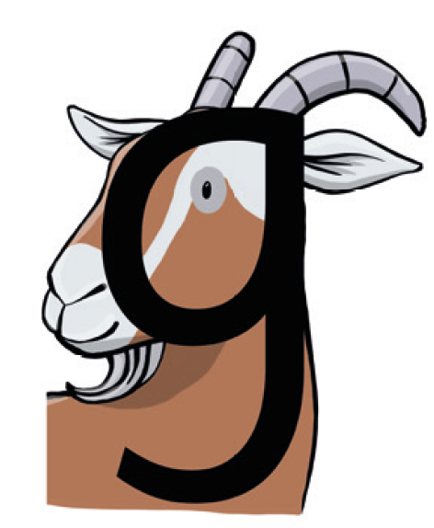
g
Watch the pencil
Round the goat’s face, up to his
ear; down and curl under his chin.
Click on the pencil to see it write.

Slide 11
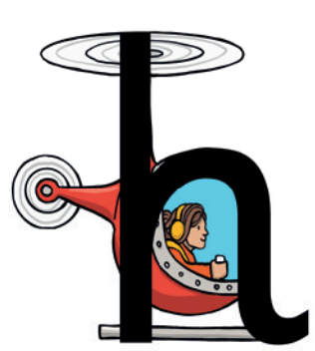
Watch the pencil
h
Down, up and over the helicopter
Click on the pencil to see it write.

Slide 12

Watch the pencil
i
Down the iguana’s body, then draw a dot [on the leaf] at the top
Click on the pencil to see it write.

Slide 13

j
Watch the pencil
All the way down the jellyfish. Dot on its head.
Click on the pencil to see it write.

Slide 14

k
Watch the pencil
Down the kite, up and across, back
and down to the corner.

Slide 15

Watch the pencil
All the way down the lollipop.
Click on the pencil to see it write.

Slide 16

m
Watch the pencil
Down, up and over the mouse’s
ears, then add a flick on the nose.
Click on the pencil to see it write.

Slide 17

n
Watch the pencil
Down the stick, up and over the net.
Click on the pencil to see it write.

Slide 18

o
Watch the pencil
All around the octopus.
Click on the pencil to see it write.

Slide 19
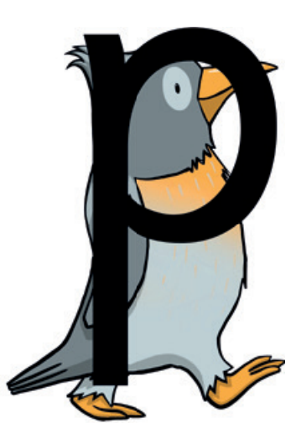
p
Watch the pencil
Down the penguin’s back, up and round its head.
Click on the pencil to see it write.

Slide 20
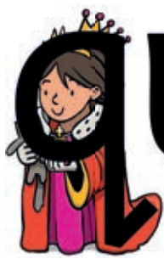
q
Watch the pencil
Round the queen’s face, up to her crown, down her robe with a flick at the end.
Click on the pencil to see it write.

Slide 21

r
Watch the pencil
From the cloud to the ground, up the arch and over the rainbow.
Click on the pencil to see it write.

Slide 22

s
Watch the pencil
Under the snake’s chin, slide down and round its tail.
Click on the pencil to see it write.

Slide 23

t
Watch the pencil
From the tiger’s nose to its tail, then follow the stripe across the tiger.
Click on the pencil to see it write.

Slide 24

Watch the pencil
Down and around the umbrella, stop at the top and down to the bottom and flick.
Click on the pencil to see it write.

Slide 25

Watch the pencil
Down to the bottom of the volcano and back up to the top.
Click on the pencil to see it write.

Slide 26

Watch the pencil
From the top of the wave to the bottom, up the wave, down the wave, then up again.
Click on the pencil to see it write.

Slide 27

x
Watch the pencil
Start at the top, then across to the bottom of the box. Start at the top, then across to the bottom of the box.
Click on the pencil to see it write.

Slide 28

y
Watch the pencil
Down and round the yo-yo, then follow the string round.
Click on the pencil to see it write.

Slide 29

z
Watch the pencil
Zip across, zag down and across the zebra.
Click on the pencil to see it write.

Slide 30
Little Wandle
Letters and Sounds
Heymann Primary and Nursery School

