Slide 1
Welcome
Reception
Curriculum Meeting
26.09.24

Slide 2
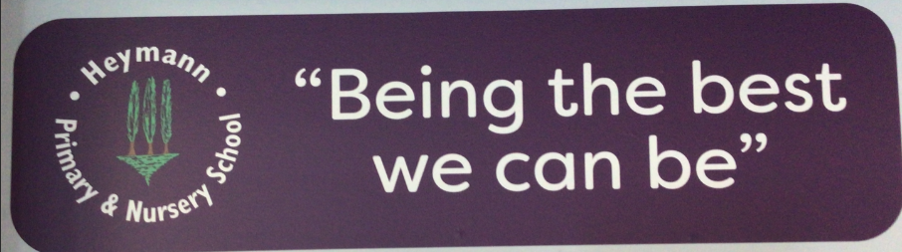
Heymann – school motto

Slide 3
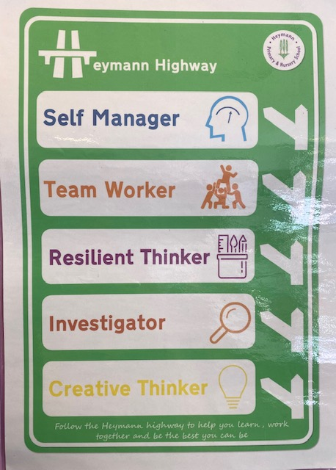
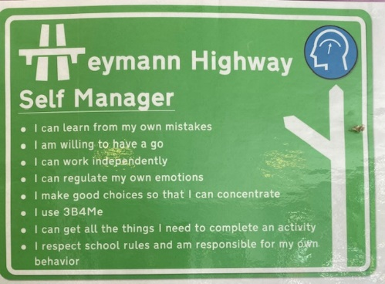
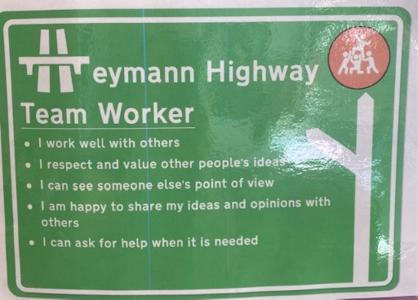
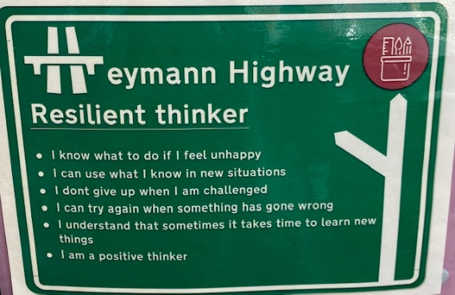
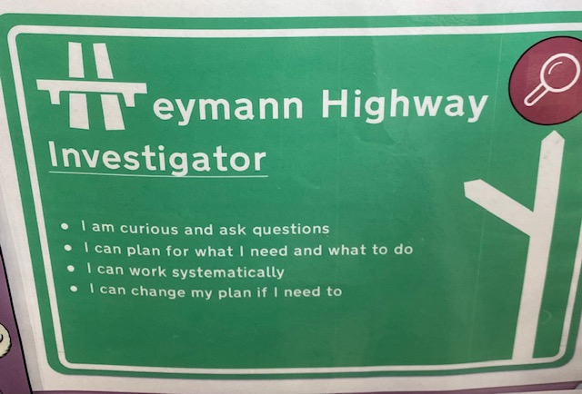
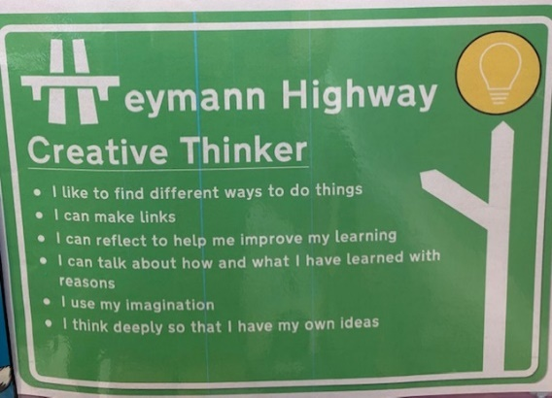
Heymann Highway
Children will receive a certificate when we see them doing these things. In our first half term we are looking for good self managers!

Slide 4
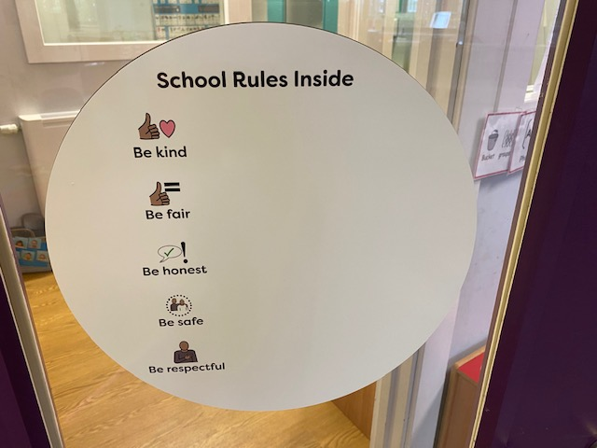
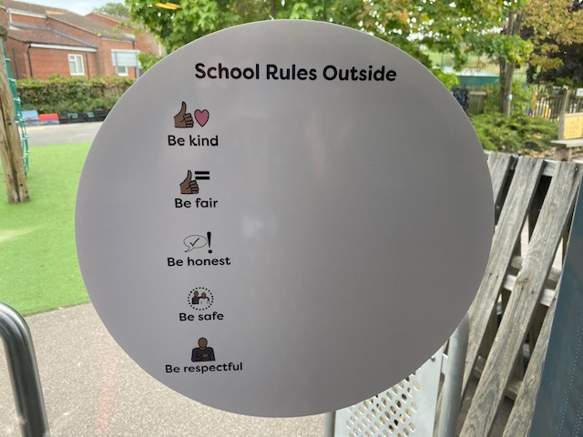
Heymann – behaviour and expectations
Children will receive…
Purple tokens for behaviour and attitude
Stickers for excellent work
Class reward system. Whole class treat when target reached.

Slide 5
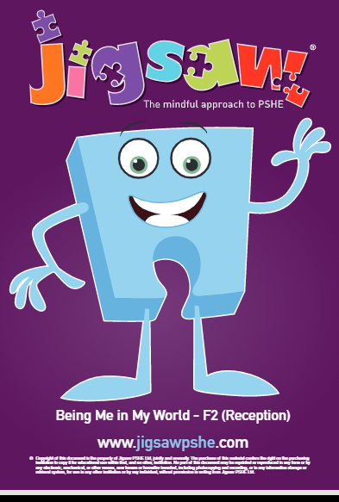
Heymann - Jigsaw
Whole school PSHE approach. Link on the reception page of the website for more information.
Spiral curriculum
Autumn 1 Being Me
1 Help others feel welcome
2 Try to make our school community a better place
3 Think about everyone’s right to learn
4 Care about other’s feelings
5 Work well with others
6 Choose to follow the Learning Charter

Slide 6
Settling your child into school.
What we are working on…
Focusing on getting to know your child and building relationships.
Showing them around the school so they get to know the staff and the building.
Looking at rules and how to play safely in the unit.
Getting to know other members of the class – ongoing.

Slide 7

Our Curruculum
Development Matters

Slide 8
Characteristics of Effective Learning
As part of our assessments we look for how children learn...
playing and exploring - children investigate and experience things, and ‘have a go’;
active learning - children concentrate and keep on trying if they encounter difficulties, and enjoy achievements; and
creating and thinking critically - children have and develop their own ideas, make links between ideas, and develop strategies for doing things.

Slide 9
Prime Areas
The Early years foundation stage curriculum is split into to parts. Each area is of equal importance.
Personal, Social and Emotional Development
Self-regulation
Managing self
Building relationships
Physical Development
Gross motor
Fine motor
Communication and Language
Listening, attention and understanding
Speaking

Slide 10
Specific Areas
Literacy
Comprehension
Word reading
Writing
Mathematics
Number
Numerical patterns
Understanding the World
People, culture and communities
The natural world
Past and present
Expressive Arts and Design
Creating with materials
Being imaginative and expressive

Slide 11
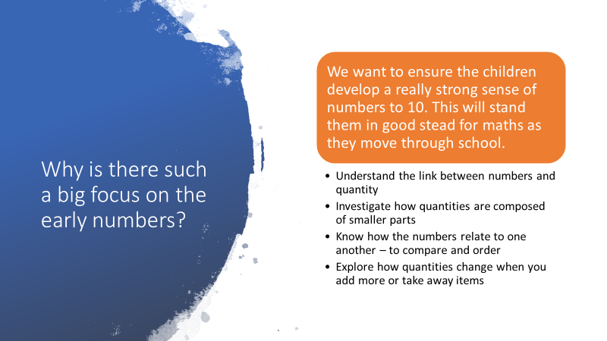
Maths

Slide 12

maths
Accurate counting
Addition
Subtraction
Number facts
Number problems

Slide 13
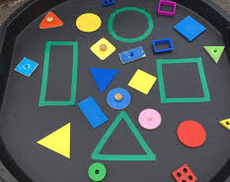
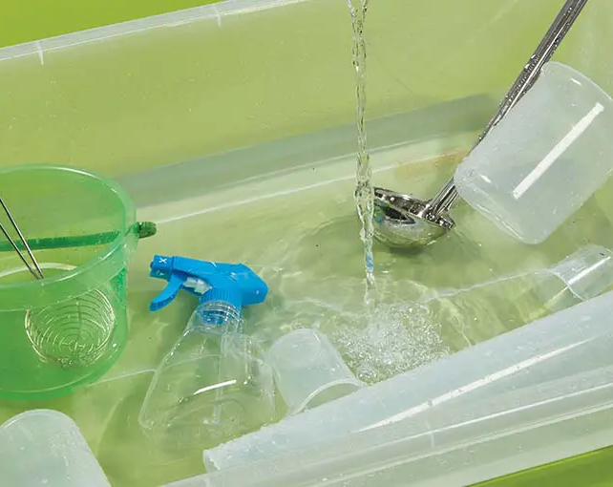
Maths shape, measures and space
2D and 3D – shape names and properties
Positional language,
Pattern
Weight, length, capacity

Slide 14
How we teach maths
Whole class sessions
Small group work
Variety of resources
Planned provision activities

Slide 15
Phonics
Little Wandle Letters and Sounds Revised
Heymann Primary School – Phonics
This page on our website will give you more information about how we teach phonics and reading at Heymann

Slide 16

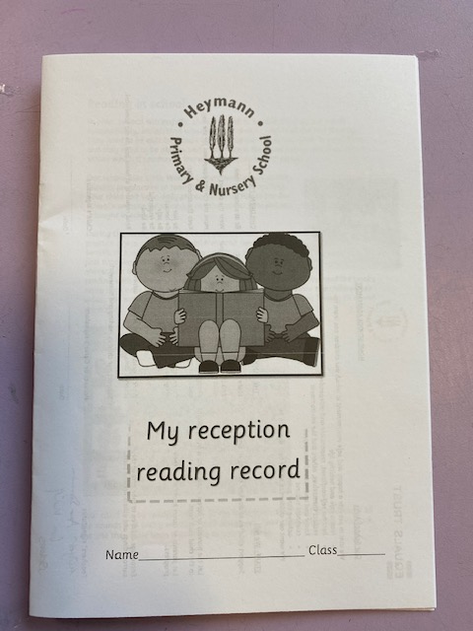
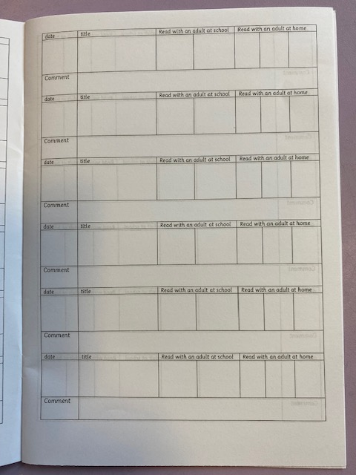
Reading and communication home
We will read with your child twice a week in a small group. This book will then come home for them to practice.
Your child will also bring home a book to share with you. It will not be a book they can read themselves.
Throughout the year we have a number of books which we will read with the children and make sure they are familiar with them. These make up our reading spine. A list of these can be found on our website in the reception reading section.
Reading record

Slide 17
Reading and communication home
✓
✓
1.10.24
Sid sits
Sometimes the teacher may write a comment here

Slide 18

Writing

Slide 19
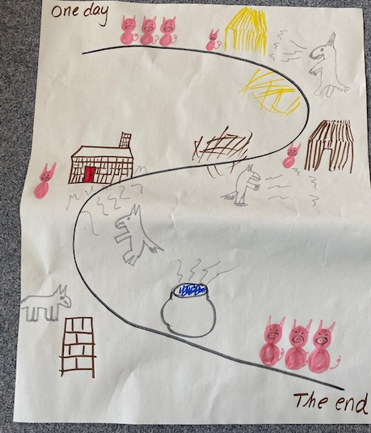
Talk for Write
Children learn actions and use props to re-tell stories.
First
Next
After that
Unfortunately
Luckily
Finally

Slide 20
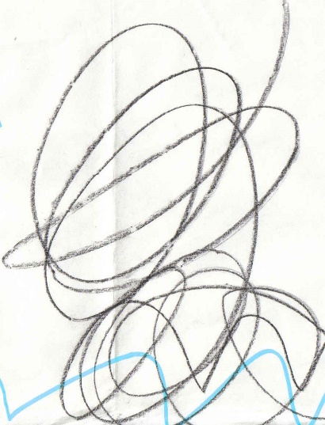
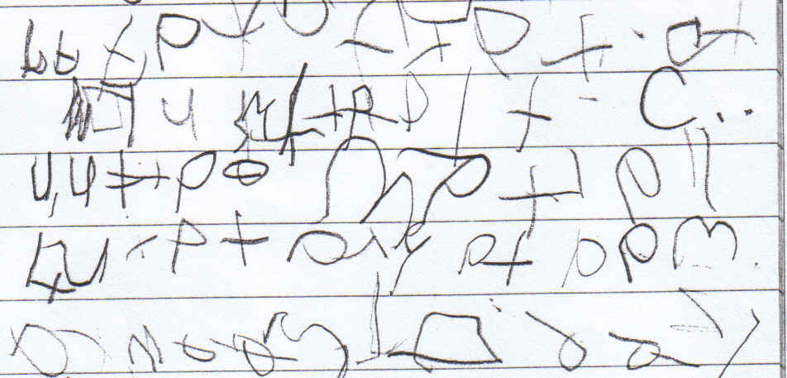
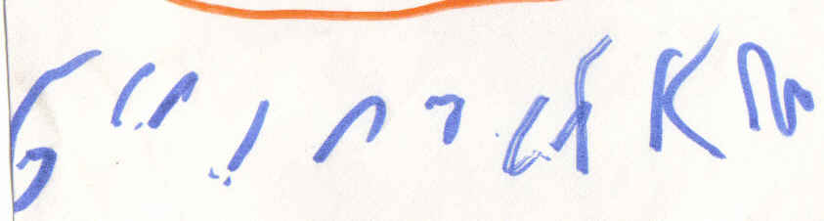
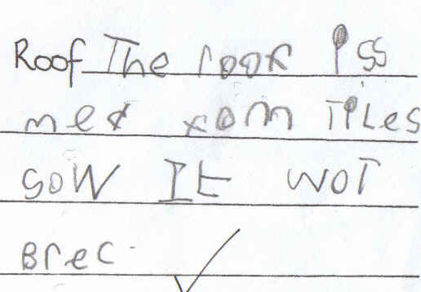
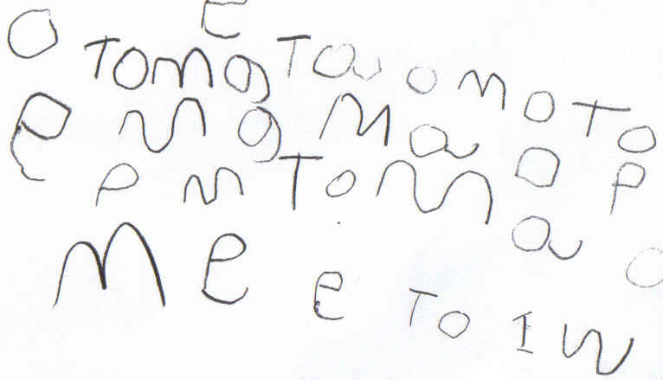
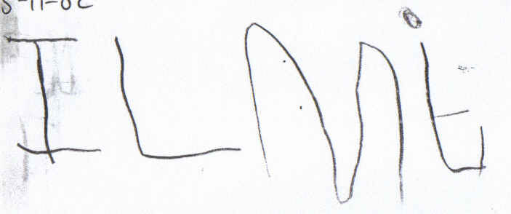
Different stages

Slide 21
handwriting
We teach Block letter formation
See PPT on our webpage

Slide 22


a
Watch the pencil
Around the astronaut’s helmet, and down into space
Click on the pencil to see it write.

Slide 23
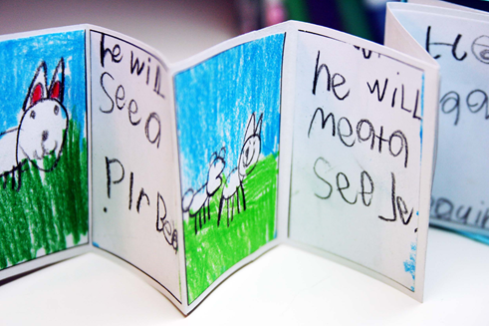
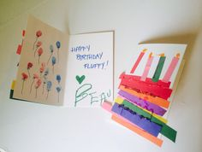
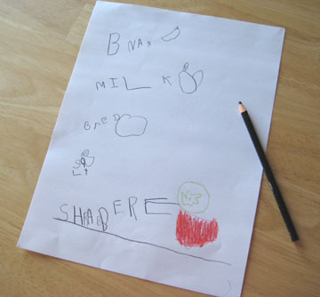
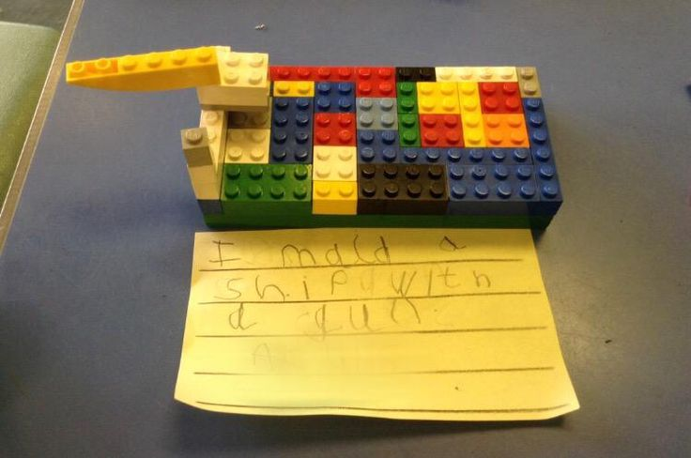
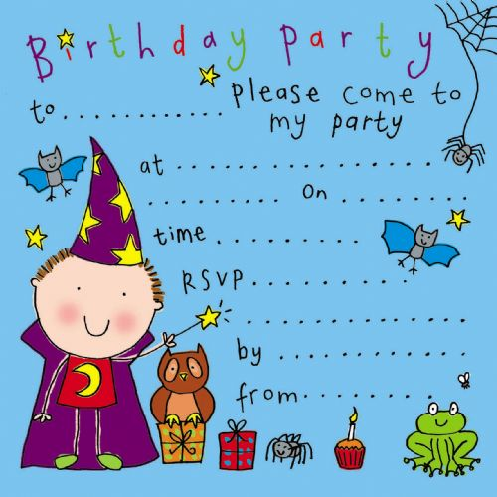
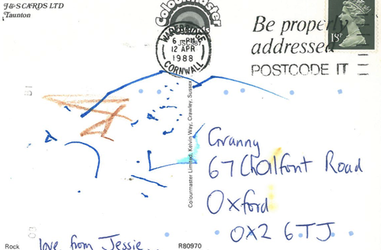
Encouraging writing at home

Slide 24
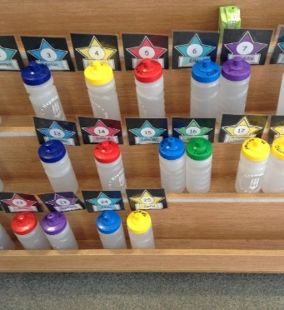
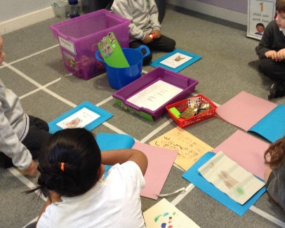
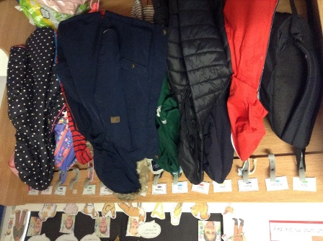
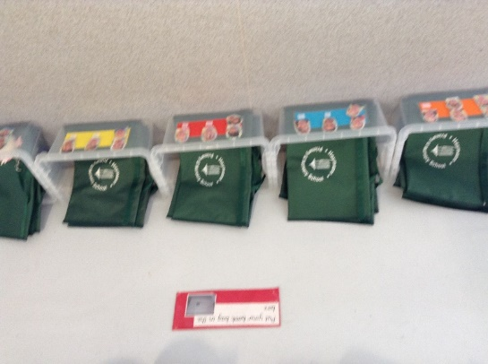
A Typical Day…
Morning routine

Slide 25
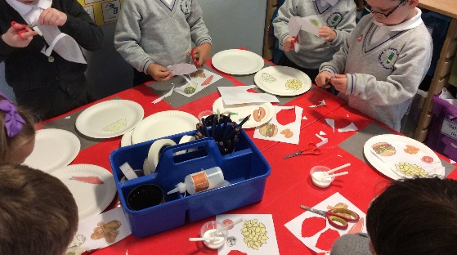
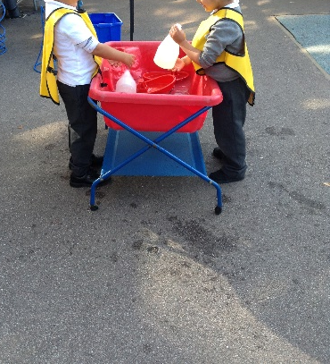
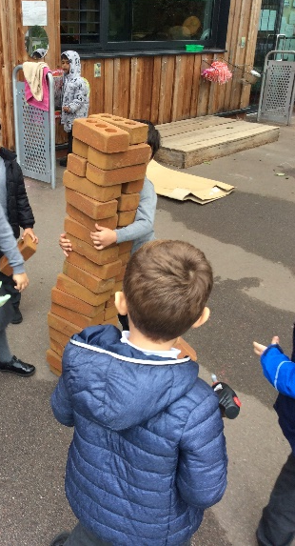
A Typical Day…..
Continuous Provision

Slide 26
communication
Details of all these things can be found on the reception page of our school website.
Talk Tasks
Challenges
All about me photograph show and tell
Enrichment activities
Parents evenings
Webpage, emails, newsletters, check book bags

Slide 27
Final Plea
Please can you name all clothing. School uniform
PE kit in school all half term. PE is on a Friday.
Bring a water bottle every day – with water only, please.
Green Book bags every day, with books inside.
No Jewellery in school.
Running late – Please go to the office. School starts at 8:40
Talk to us – End of the day we have more time. Please can you wait until all children have been dismissed.

Slide 28
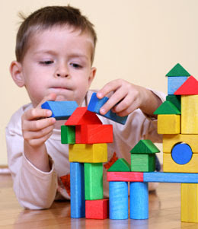
Something to remember
Children are wired to learn at their own pace, in their own way….
They are never not learning.

